Slide 1
MAD Lab presentation
Vaibhav K V
Rajit Roy
Raghav Shrivastava

Slide 2
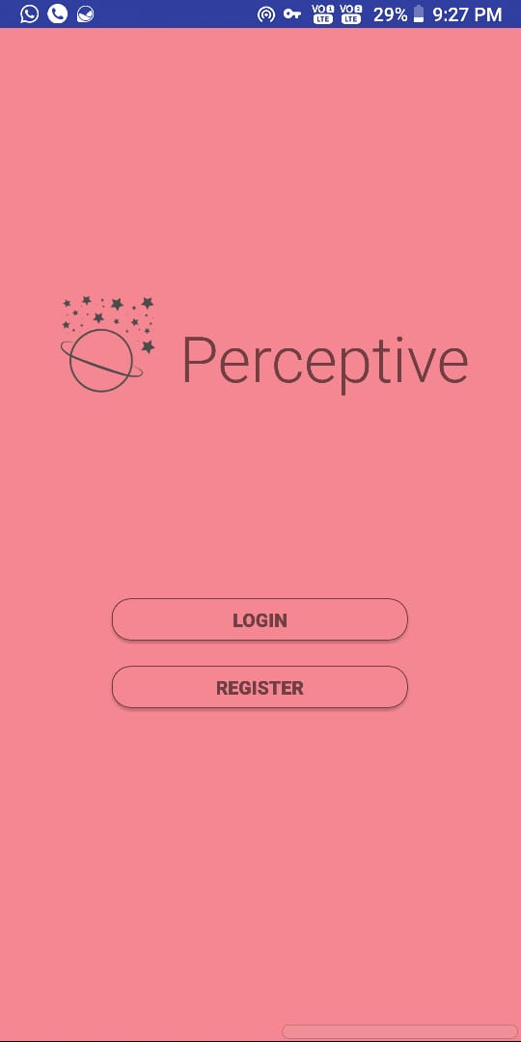
Landing screen

Slide 3
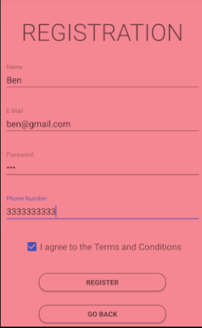
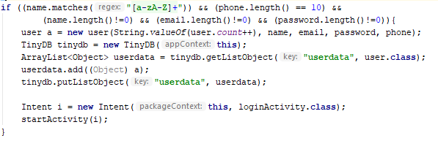
This enters the registration details into the database.

Slide 4
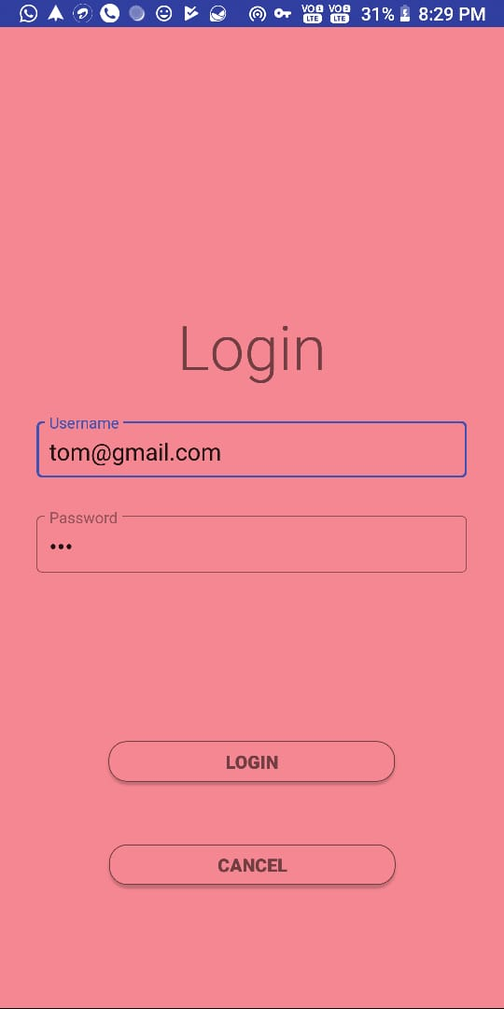
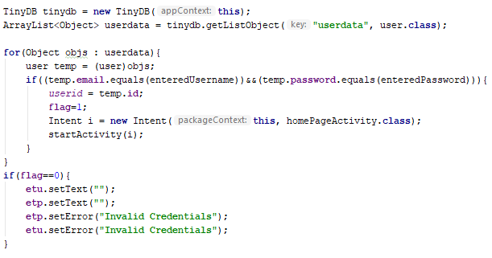
This validates the login credentials entered with the database.

Slide 5
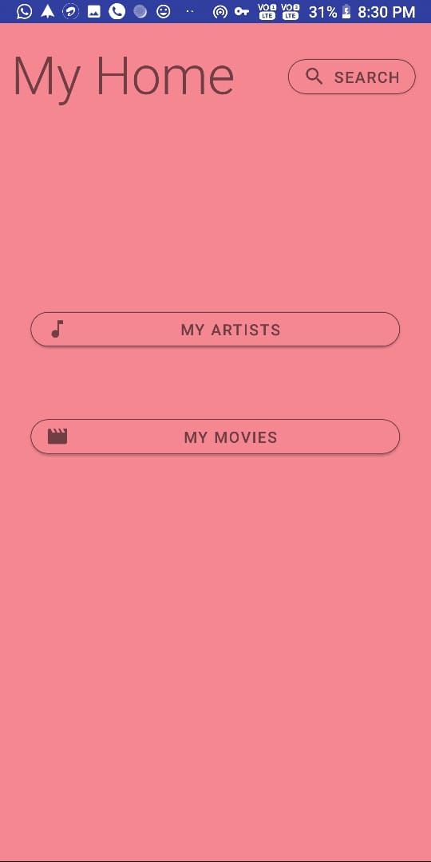
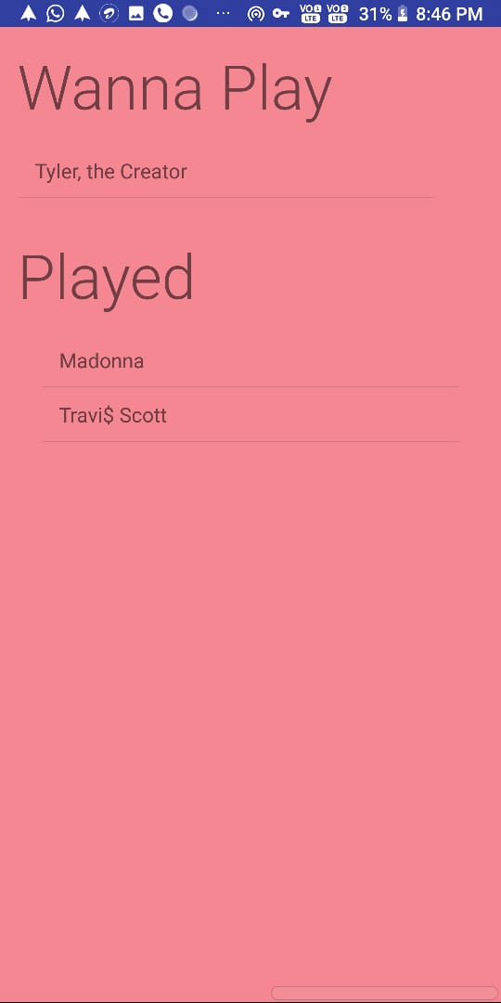

Slide 6
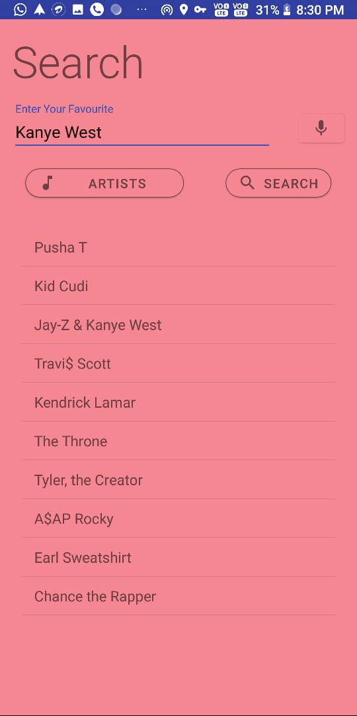
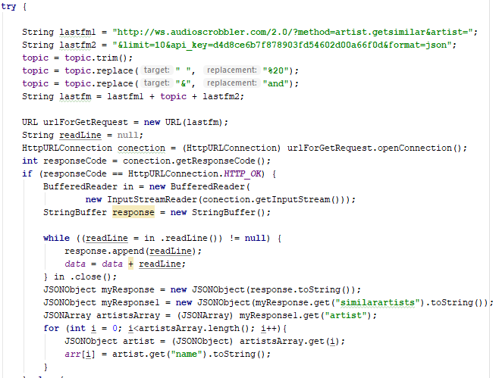
This provides us with similar artists or movies based on the search.

Slide 7
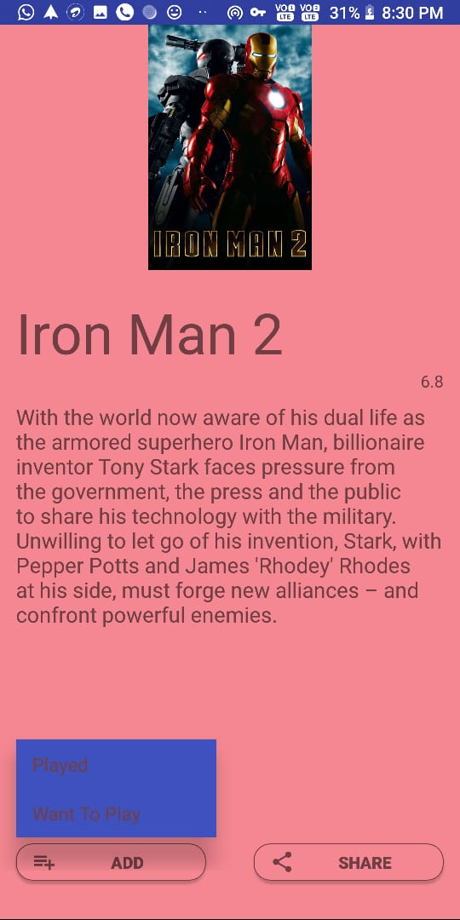
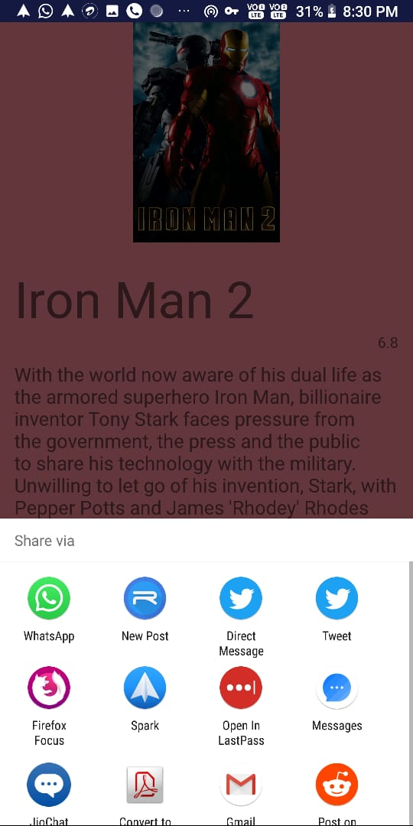
Results and share page-

Slide 8
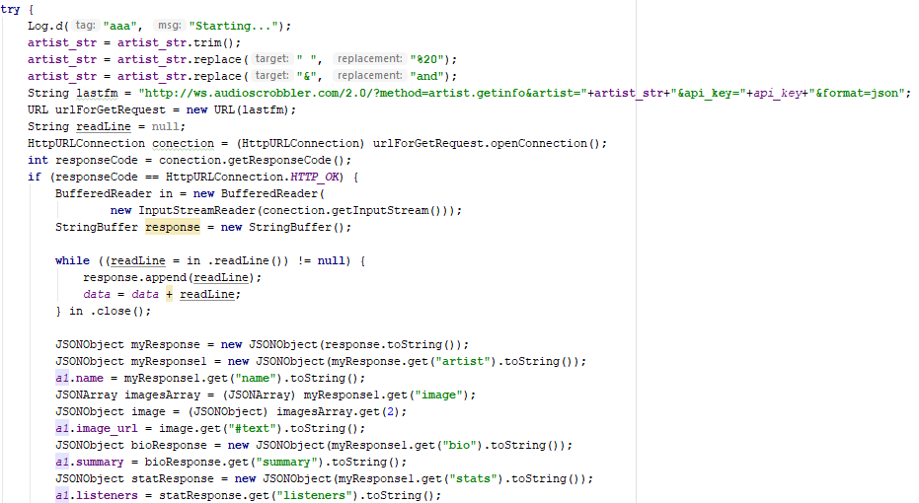
This fetches artist’s name, description, listeners/ratings and their image.

Slide 9
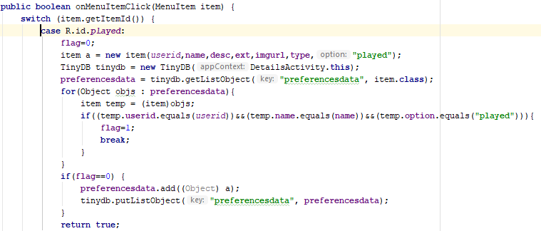
Adds the item to the database

Slide 10
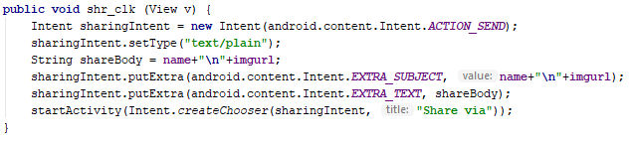
This adds the share function

Slide 11
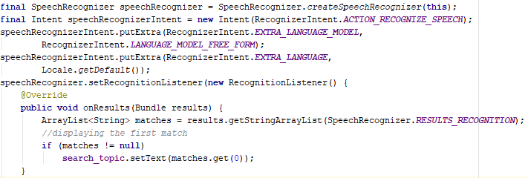
This activates voice search functionality.

Slide 12
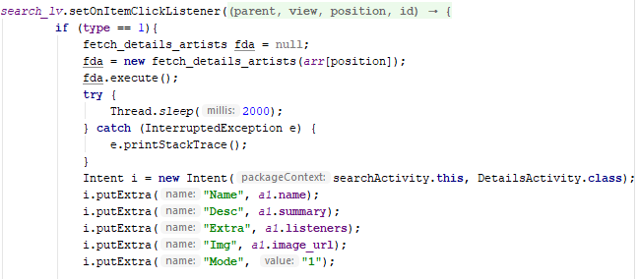
This calls the API for searching and sets the data.

Slide 13
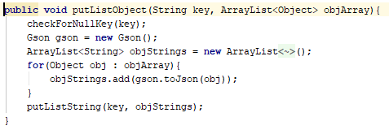
This uses shared preferences to store the list object.

Slide 14
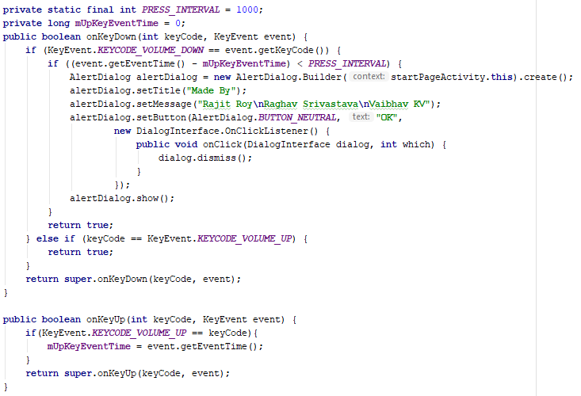
About us page opens on volume up-down key press

Slide 15
Thank you

